Slide 1
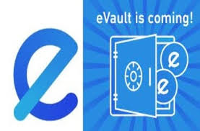
DEVELOPING A BLOCKCHAIN - BASED EVAULT FOR LEGAL RECORDS
Done by,
Suvalakshmi S - 23PB37

Slide 2
INTRODUCTION
In today’s digital age, managing and safeguarding legal records efficiently is more crucial than ever. Traditional methods often involve cumbersome paperwork and are susceptible to errors or loss.
To address these challenges, the E-Vault Legal Records System is introduced, which is a cutting-edge solution leveraging blockchain technology to ensure the integrity, security, and accessibility of legal documents.
The E-Vault system is built on Ethereum’s blockchain, offering a decentralized platform where legal records are securely stored and managed.
By utilizing smart contracts, the system automates the process of document registration, verification, and retrieval. This eliminates the need for intermediaries, reduces costs, and enhances transparency.
With features like immutability and tamper-proofing, the E-Vault system guarantees that once a document is registered, it cannot be altered or deleted, ensuring its authenticity and reliability.

Slide 3
TECHNICAL EXPLANATION
The E-Vault Legal Records System uses blockchain technology to securely manage legal documents. At its core, it leverages a distributed ledger to record and verify documents in a tamper-proof manner. When a document is added to the system, it is stored as a unique digital record on the blockchain. This record includes cryptographic proofs that ensure its integrity and authenticity.
Smart contracts, self-executing agreements with the terms directly written into code, handle the automation of key processes like document registration and verification. This minimizes the need for intermediaries and reduces the risk of human error.
The system offers a user-friendly interface that allows users to interact with the blockchain easily. It enables efficient and transparent management of documents, providing a secure environment where records are immutable and easily retrievable, enhancing both reliability and trust in legal documentation.

Slide 4
NEED FOR BLOCKCHAIN
Blockchain technology is crucial for the E-Vault Legal Records System due to its inherent properties of security, transparency, and immutability. Traditional systems for managing legal records often face challenges like data tampering, loss, and unauthorized access. Blockchain addresses these issues by providing a decentralized ledger where each transaction is cryptographically secured and linked to the previous one, ensuring that records cannot be altered or deleted once added.
This immutability guarantees the authenticity and integrity of legal documents, which is essential for legal processes. Furthermore, blockchain's transparency allows for a verifiable audit trail, making it easier to trace document history and verify authenticity. The decentralized nature of blockchain eliminates the need for intermediaries, reducing costs and speeding up the verification process.
Overall, blockchain ensures a secure, reliable, and efficient system for managing and safeguarding legal records, enhancing trust and efficiency in legal documentation.

Slide 5
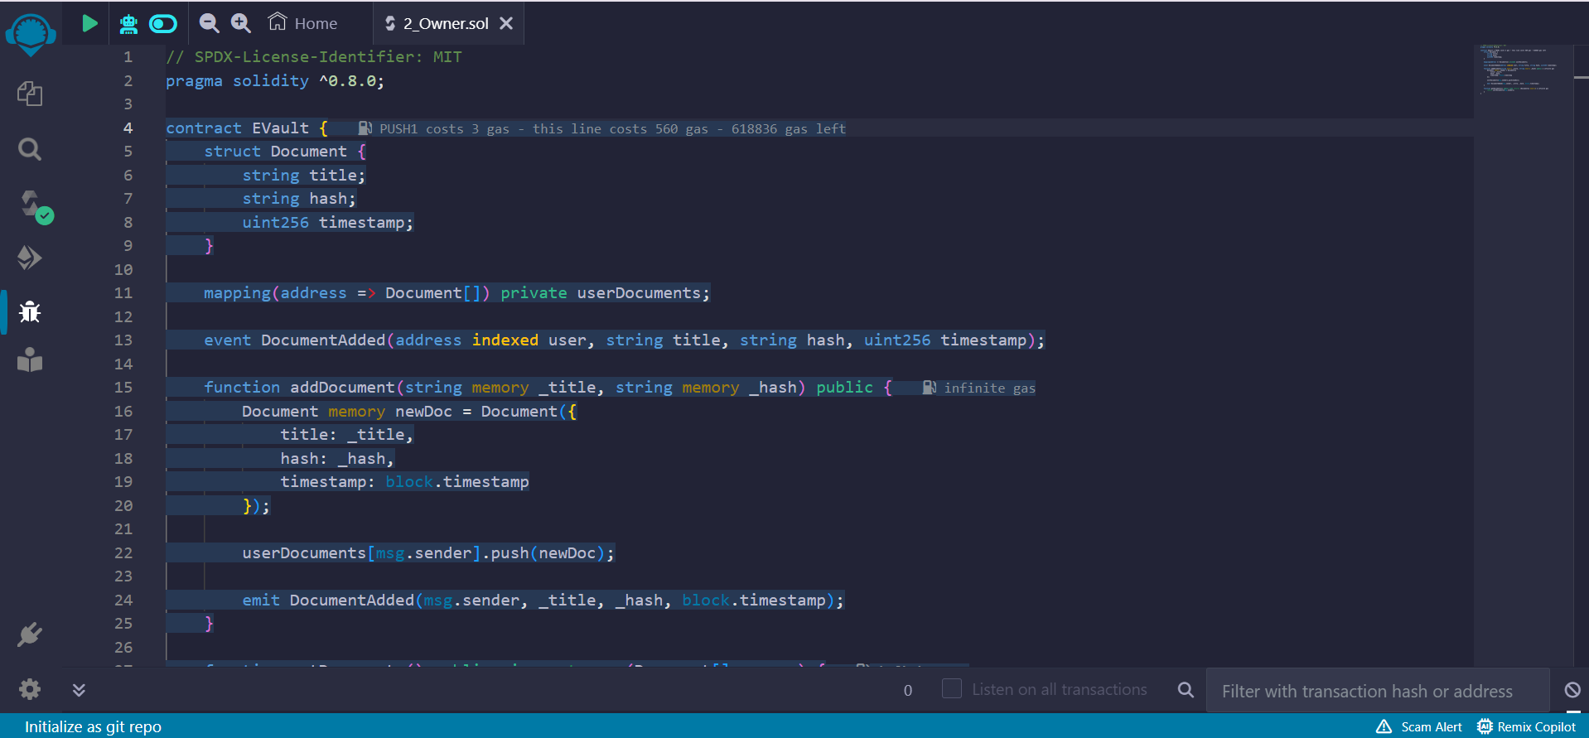
BLOCKCHAIN IMPLEMENTATION

Slide 6
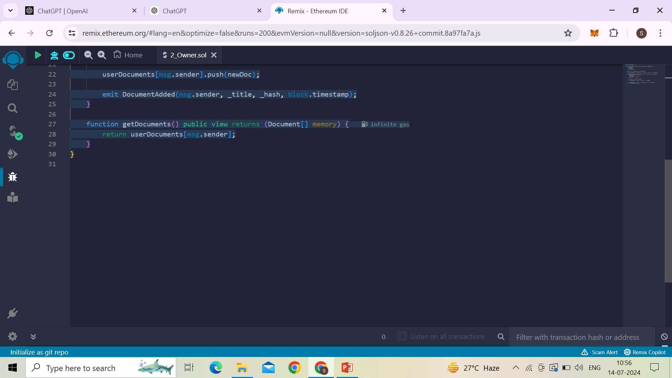

Slide 7
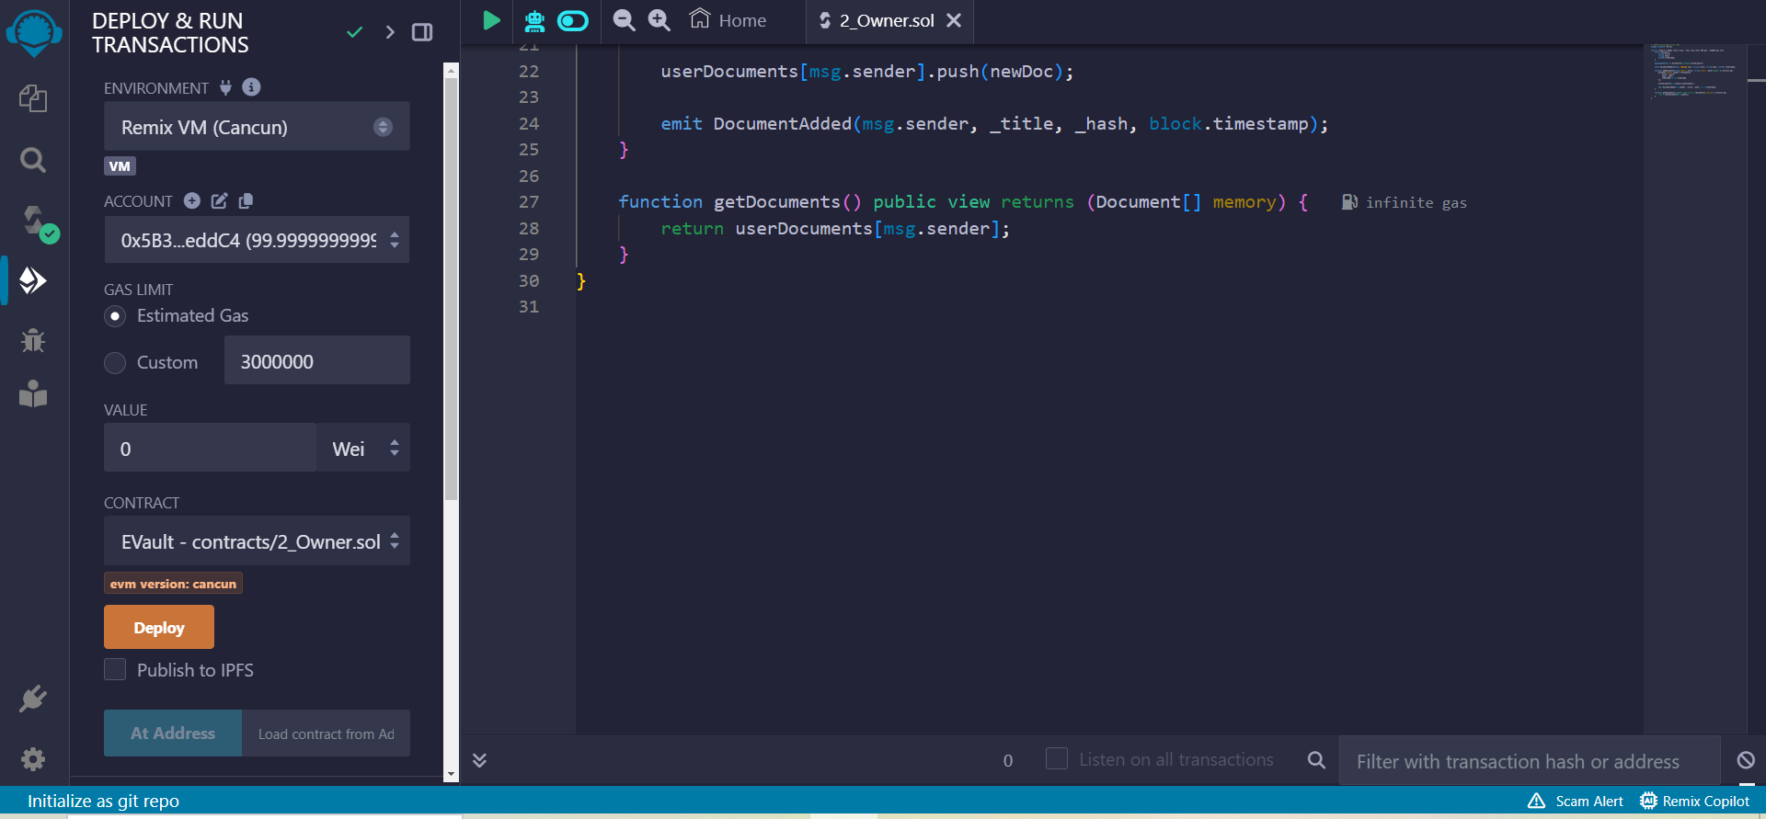

Slide 8
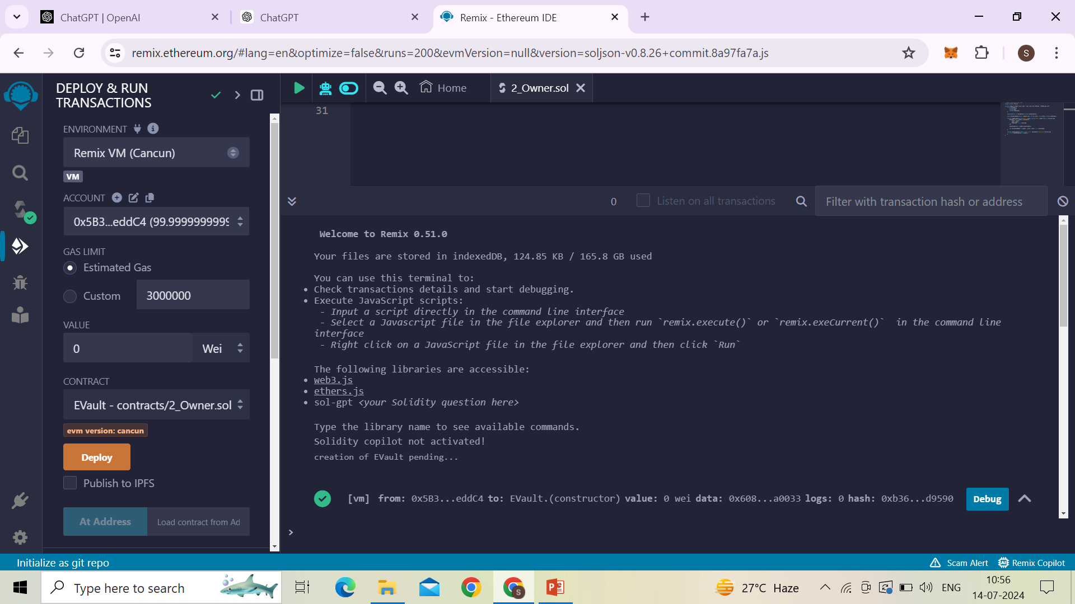

Slide 9
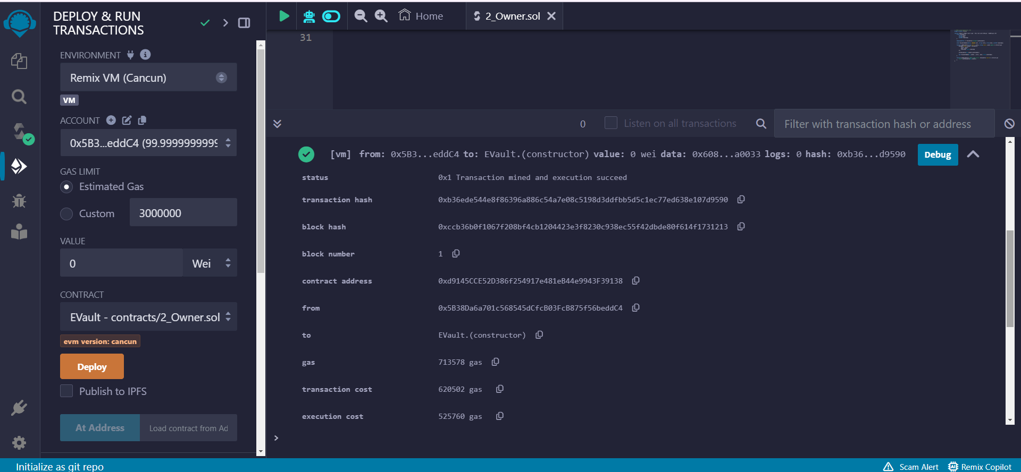

Slide 10
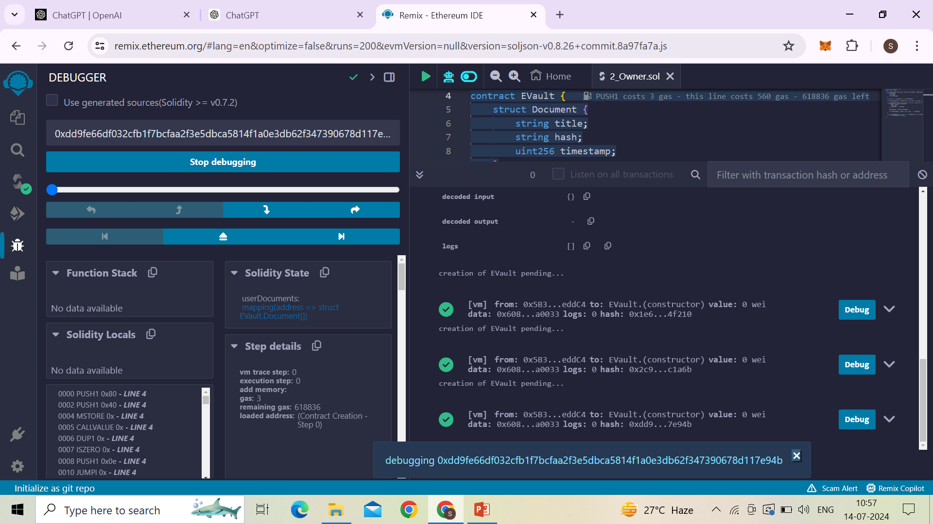

Slide 11
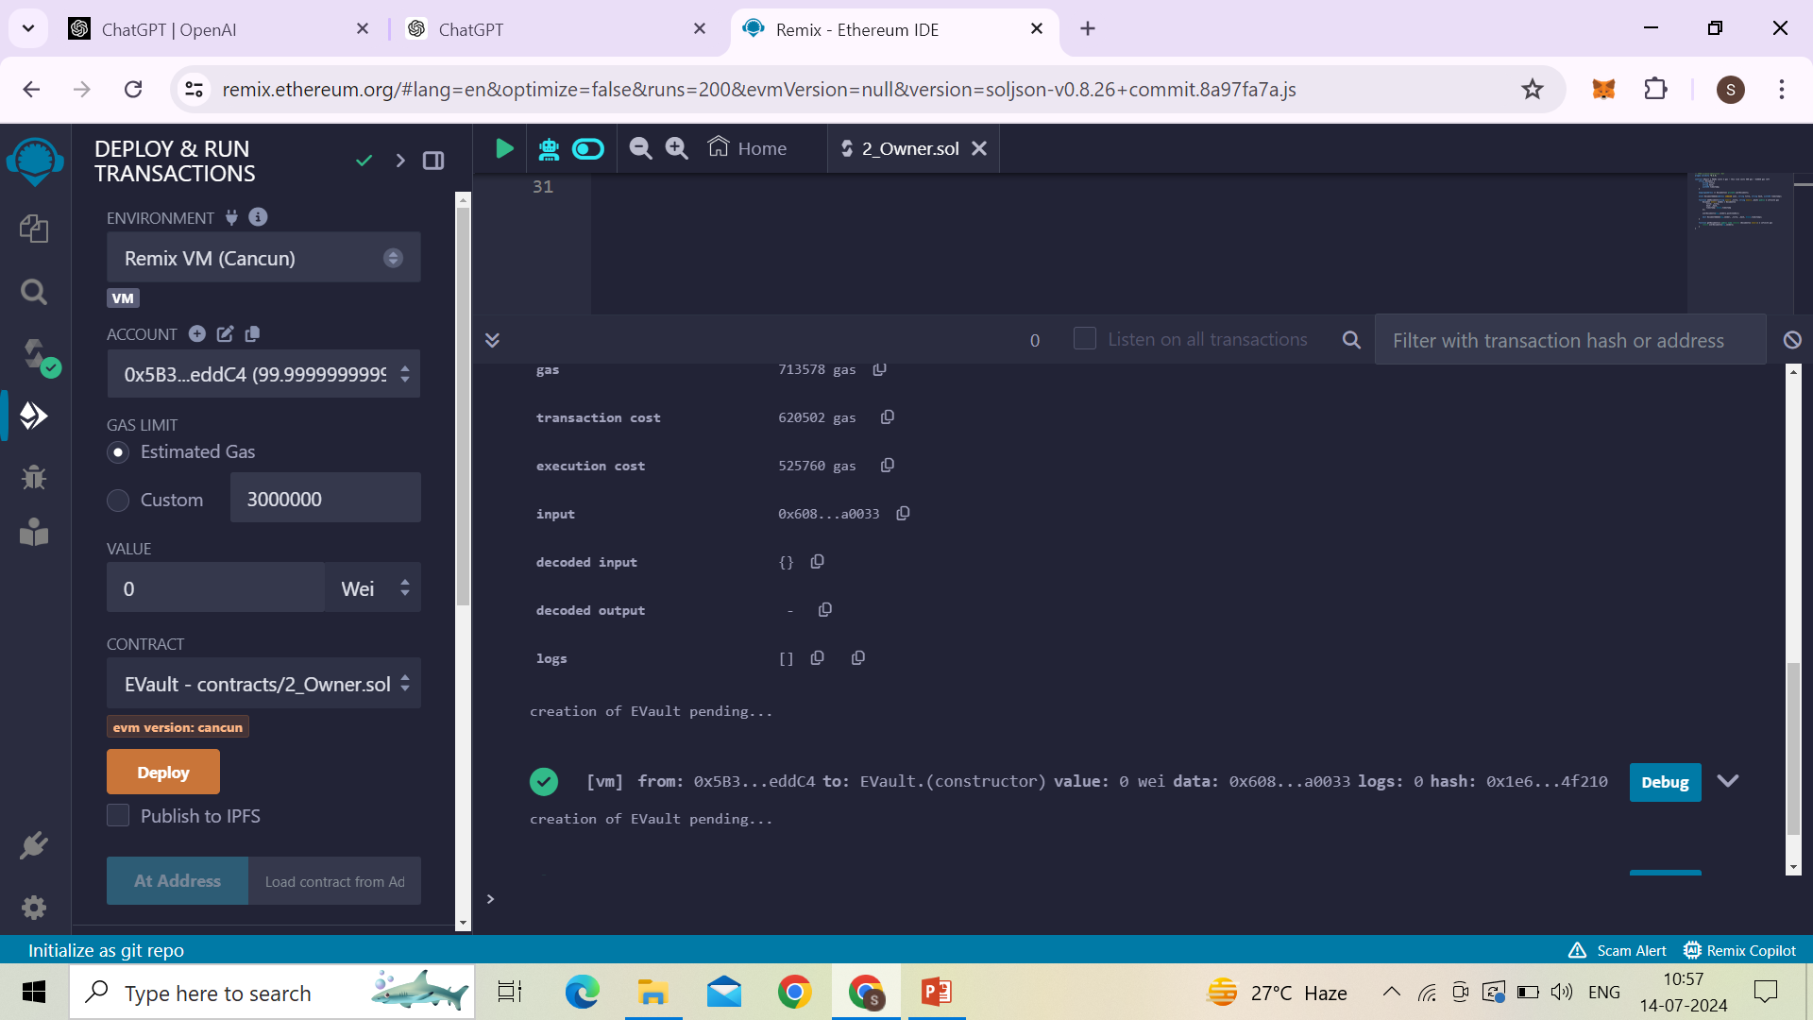

Slide 12
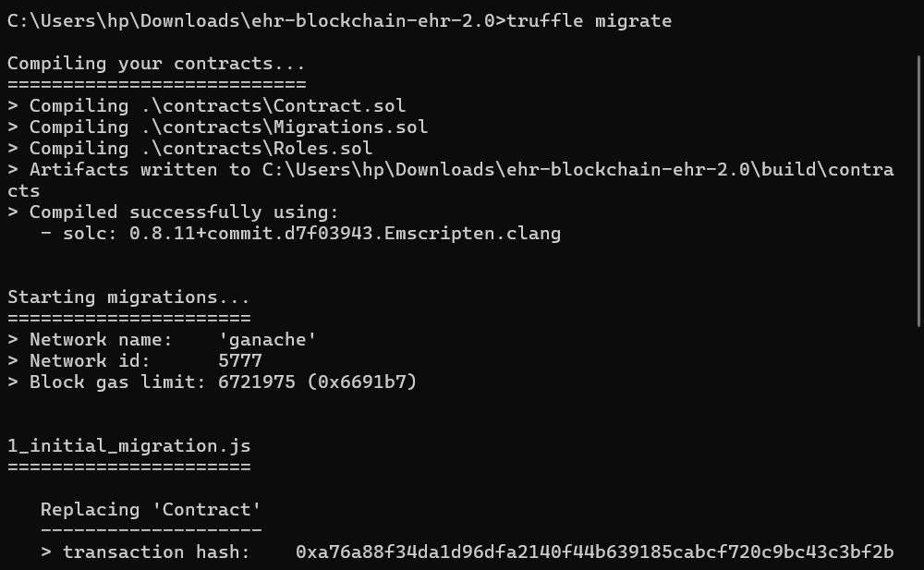
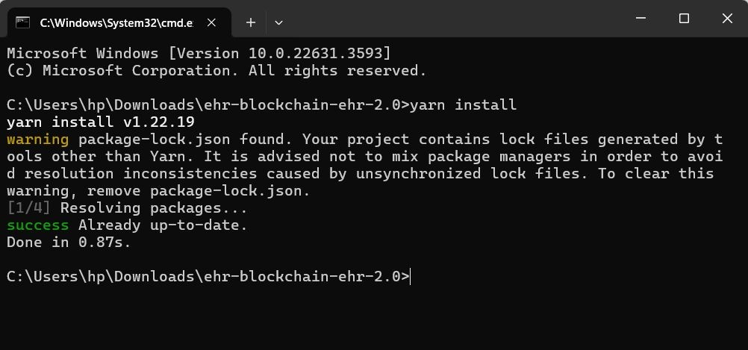
RESULT ANALYSIS

Slide 13
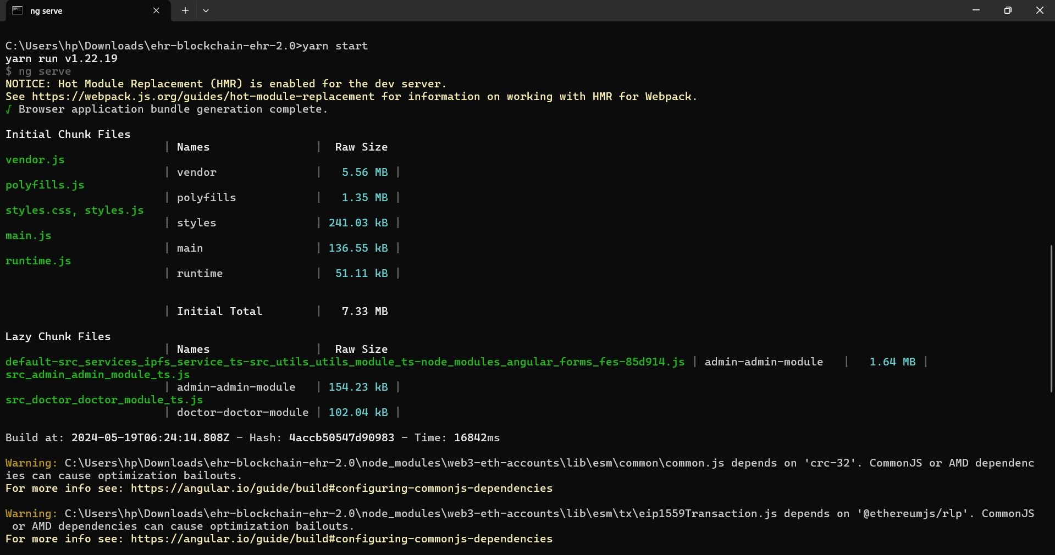

Slide 14
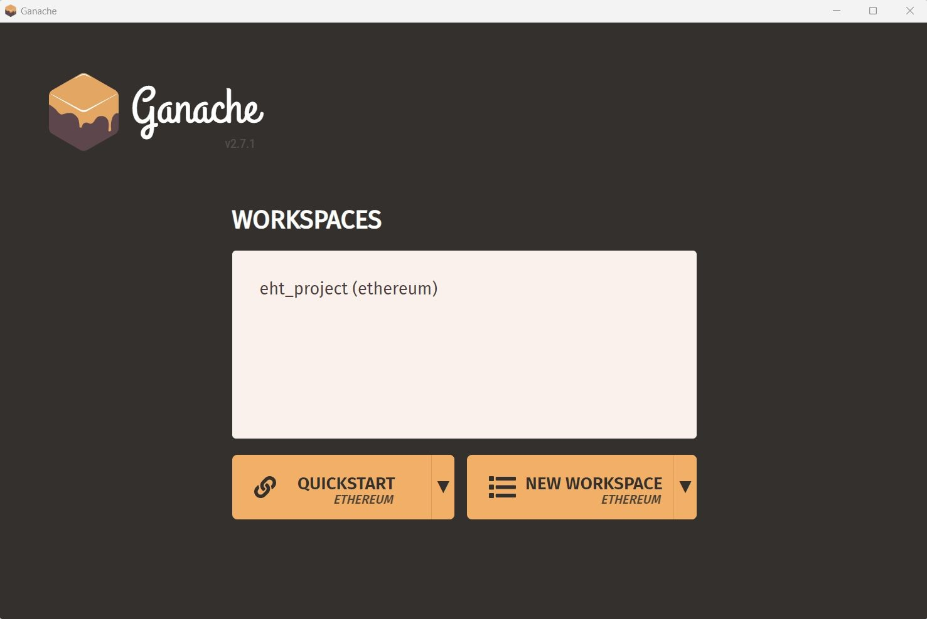
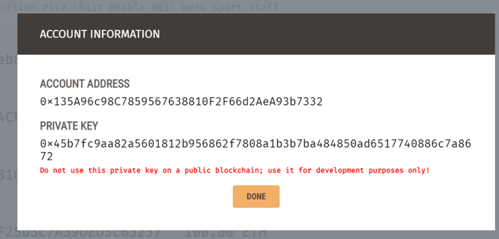
GANACHE

Slide 15
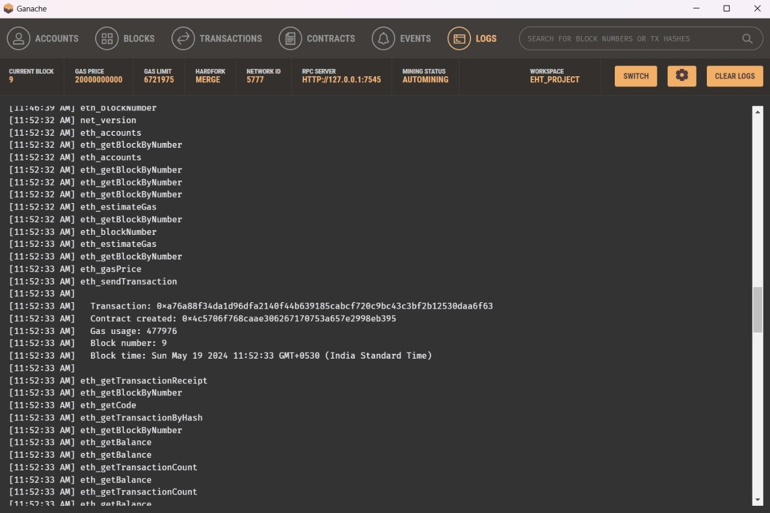
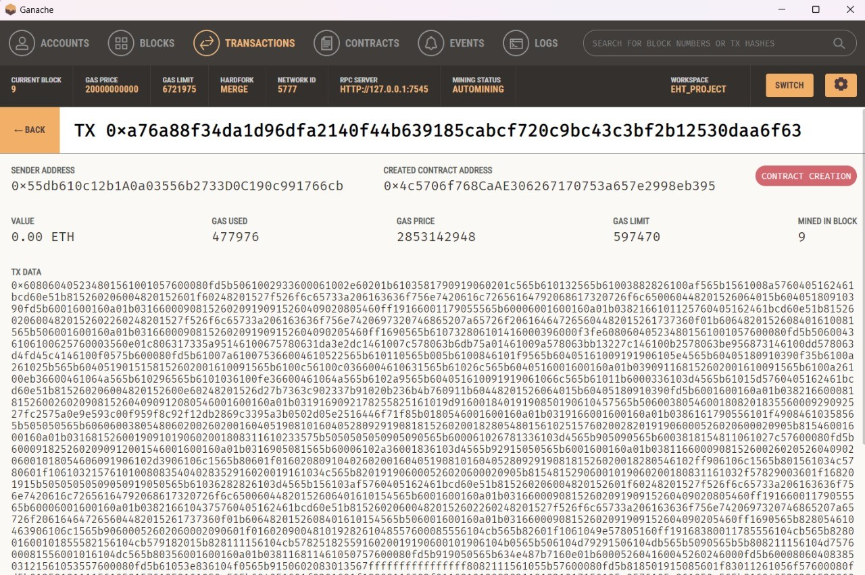

Slide 16
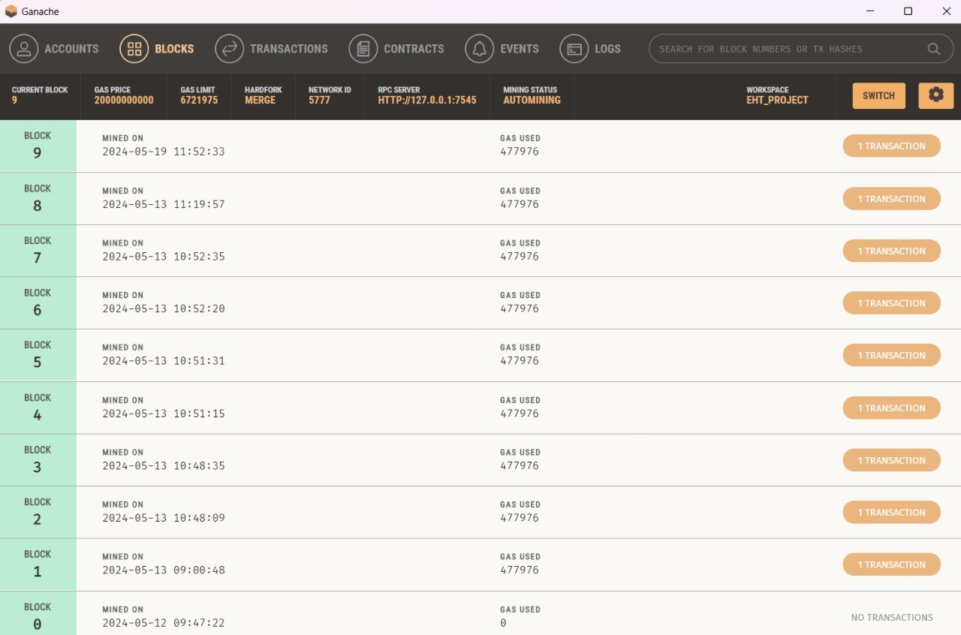
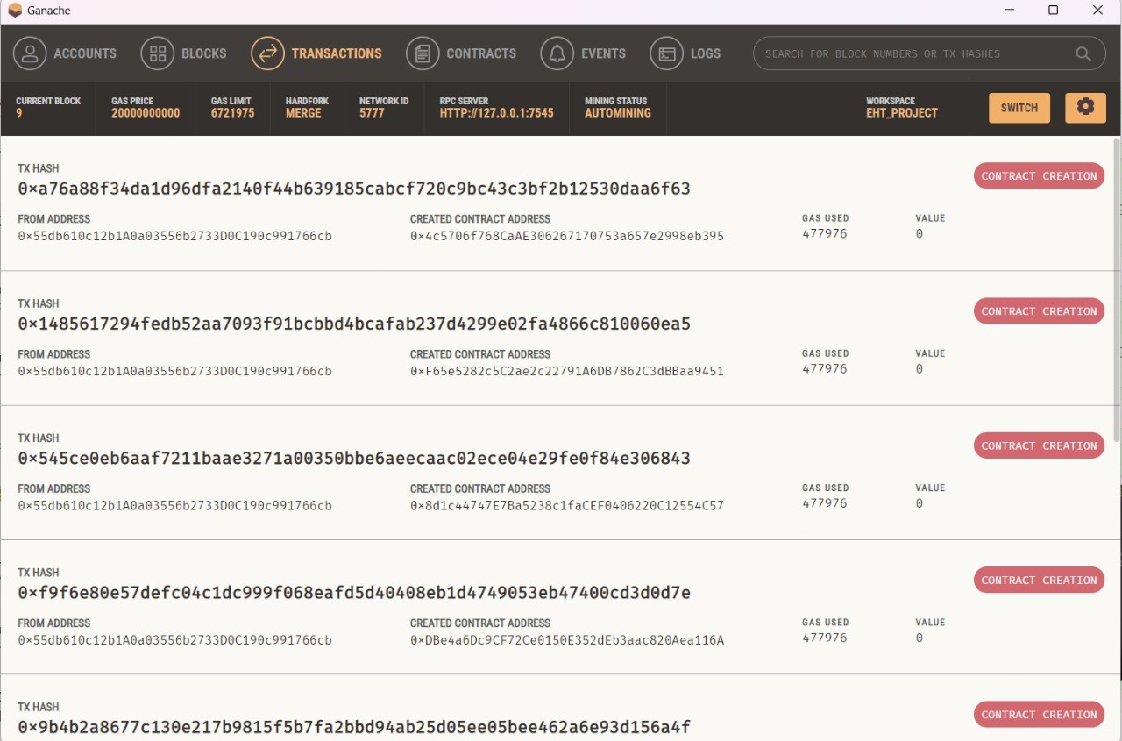

Slide 17
Ganache is a personal blockchain for Ethereum development that allows developers to deploy smart contracts, run tests, and execute commands in a controlled environment.
It simulates the Ethereum blockchain on a local machine, providing a fast and predictable platform for testing decentralized applications (dApps).
Ganache offers features like instant mining, customizable gas fees, and advanced logging, making it easier to debug and develop blockchain projects.
It supports both graphical and command-line interfaces, catering to different development needs.
By using Ganache, developers can ensure their smart contracts and dApps work correctly before deploying them to the live Ethereum network.

Slide 18

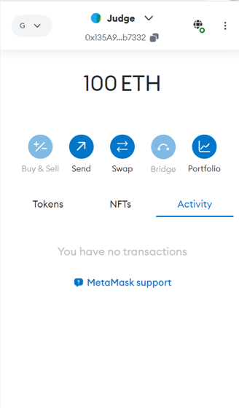
META MASK

Slide 19
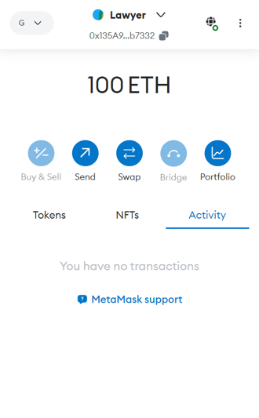
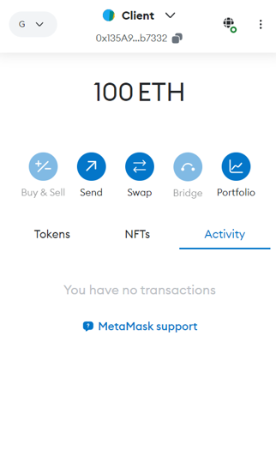

Slide 20
MetaMask, a digital wallet and gateway to blockchain applications, plays a crucial role in the E-Vault Legal Records System.
It allows judges, lawyers, and clients to securely interact with the blockchain. Judges can verify the authenticity and integrity of legal documents directly.
Lawyers can upload, manage, and share documents with clients and other legal professionals, ensuring confidentiality and security.
Clients can access their legal records, verify their status, and share them when necessary.
MetaMask ensures secure authentication, enabling these stakeholders to seamlessly and securely interact with the blockchain-based e-vault system.

Slide 21
CONCLUSION
The E-Vault Legal Records System represents a significant advancement in the management and security of legal documents.
By harnessing the power of blockchain technology, it ensures that legal records are immutable, transparent, and highly secure.
This system addresses the limitations of traditional document management, such as vulnerability to tampering and inefficiencies in verification processes.
With smart contracts automating the registration and verification of documents, the need for intermediaries is reduced, leading to cost savings and faster processing times. Judges, lawyers, and clients benefit from a reliable and efficient system that guarantees the authenticity and integrity of legal records.
Overall, the E-Vault Legal Records System sets a new standard for the digital handling of legal documentation, fostering greater trust and efficiency in legal proceedings.

Slide 22
THANK YOU!

